Slide 1
Chapter 7
Working with Databases and MySQL
PHP Programming with MySQL
2nd Edition

Slide 2
Objectives
In this chapter, you will:
Study the basics of databases and MySQL
Work with MySQL databases
Define database tables
Modify user privileges
Work with database records
Work with phpMyAdmin
PHP Programming with MySQL, 2nd Edition

Slide 3
Introduction to Databases
A database is an ordered collection of information from which a computer program
can quickly access information
Each row in a database table is called a record
A record in a database is a single complete set of related information
Each column in a database table is called a field
Fields are the individual categories of information stored in a record
PHP Programming with MySQL, 2nd Edition

Slide 4
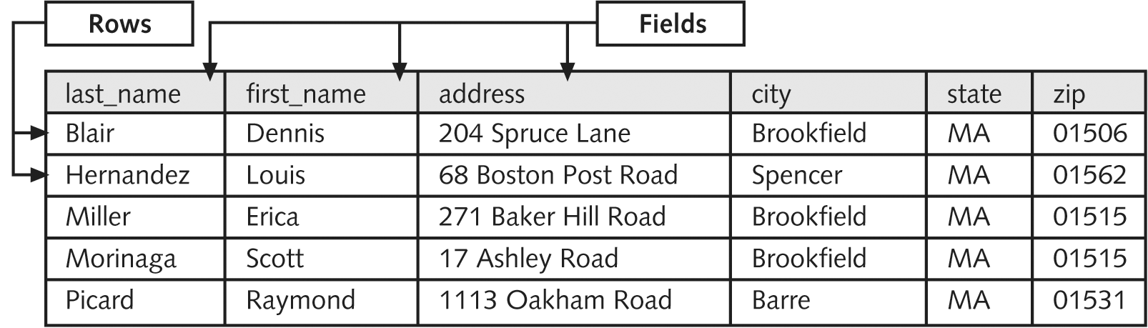
Introduction to Databases (continued)
Figure 7-1 Employee directory database
PHP Programming with MySQL, 2nd Edition

Slide 5
Introduction to Databases (continued)
A flat-file database stores information in a single table
A relational database stores information across multiple related tables
PHP Programming with MySQL, 2nd Edition

Slide 6
Understanding Relational Databases
Relational databases consist of one or more related tables
A primary table is the main table in a relationship that is referenced by another table
A related table (or “child table”) references a primary table in a relational database
A primary key is a field that contains a unique identifier for each record in a primary table
PHP Programming with MySQL, 2nd Edition

Slide 7
Understanding Relational Databases (continued)
A primary key is a type of index, which identifies records in a database to make retrievals and sorting faster
A foreign key is a field in a related table that refers to the primary key in a primary table
Primary and foreign keys link records across multiple tables in a relational database
PHP Programming with MySQL, 2nd Edition

Slide 8
One-to-One Relationships
A one-to-one relationship exists between two tables when a related table contains exactly one record for each record in the primary table
Create one-to-one relationships to break information into multiple, logical sets
Information in the tables in a one-to-one relationship can be placed within a single table
Make the information in one of the tables confidential and accessible only by certain individuals
PHP Programming with MySQL, 2nd Edition

Slide 9
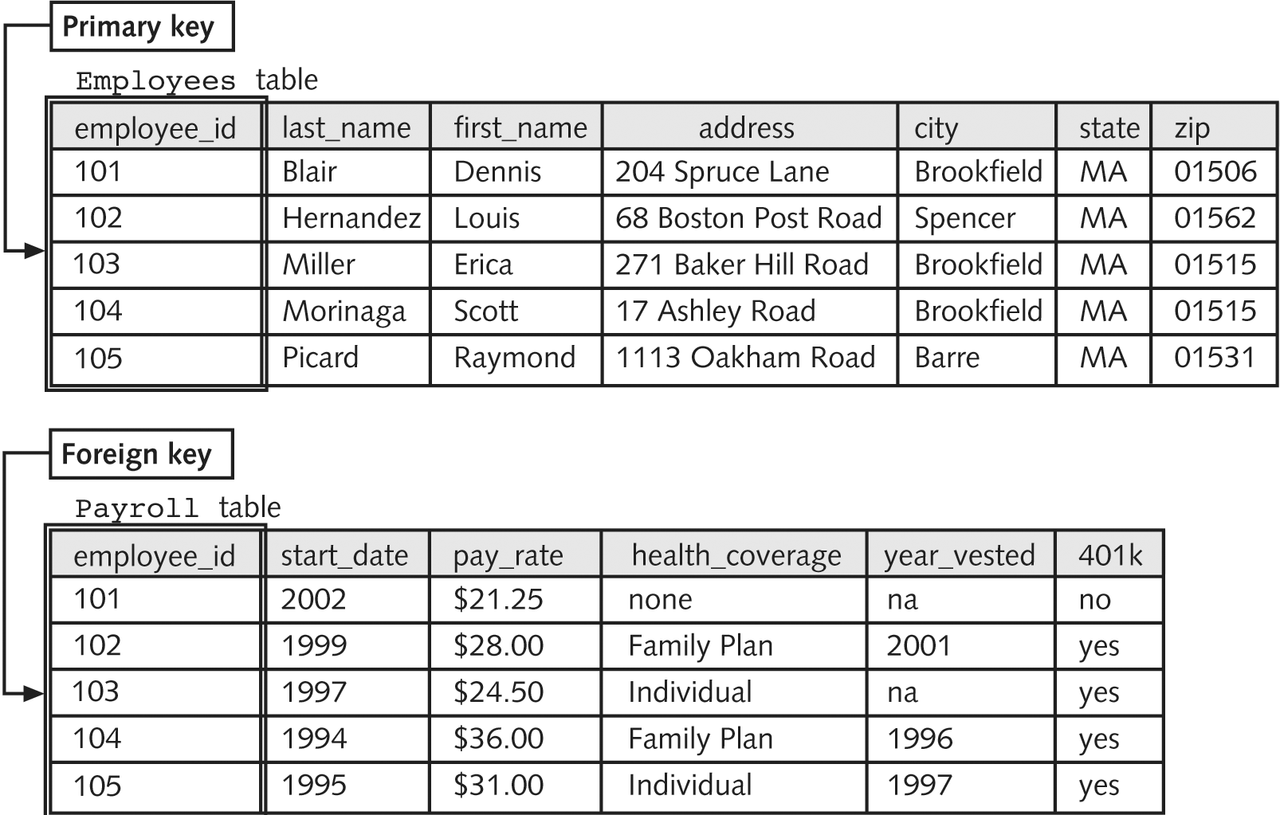
One-to-One Relationships (continued)
Figure 7-2 One-to-one relationship
PHP Programming with MySQL, 2nd Edition

Slide 10
One-to-Many Relationship
A one-to-many relationship exists in a relational database when one record in a primary table has many related records in a related table
Breaking tables into multiple related tables to reduce redundant and duplicate information is called normalization
Provides a more efficient and less redundant method of storing this information in a database
PHP Programming with MySQL, 2nd Edition

Slide 11
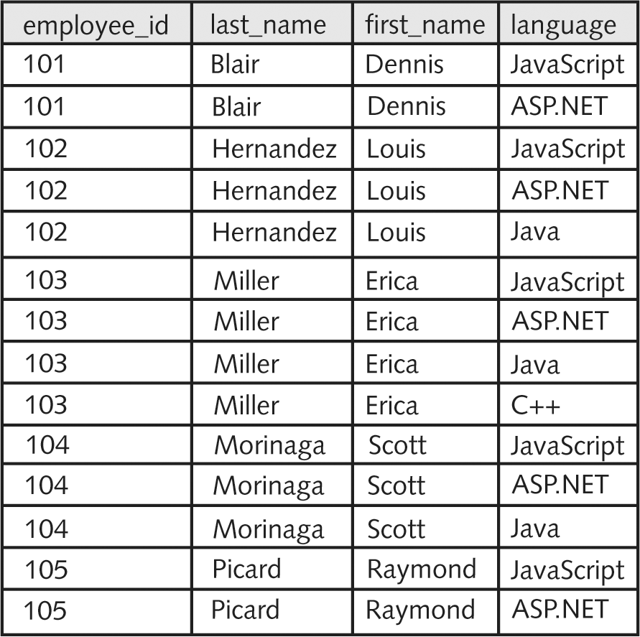
One-to-Many Relationship (continued)
Figure 7-3 Table with redundant information
PHP Programming with MySQL, 2nd Edition

Slide 12
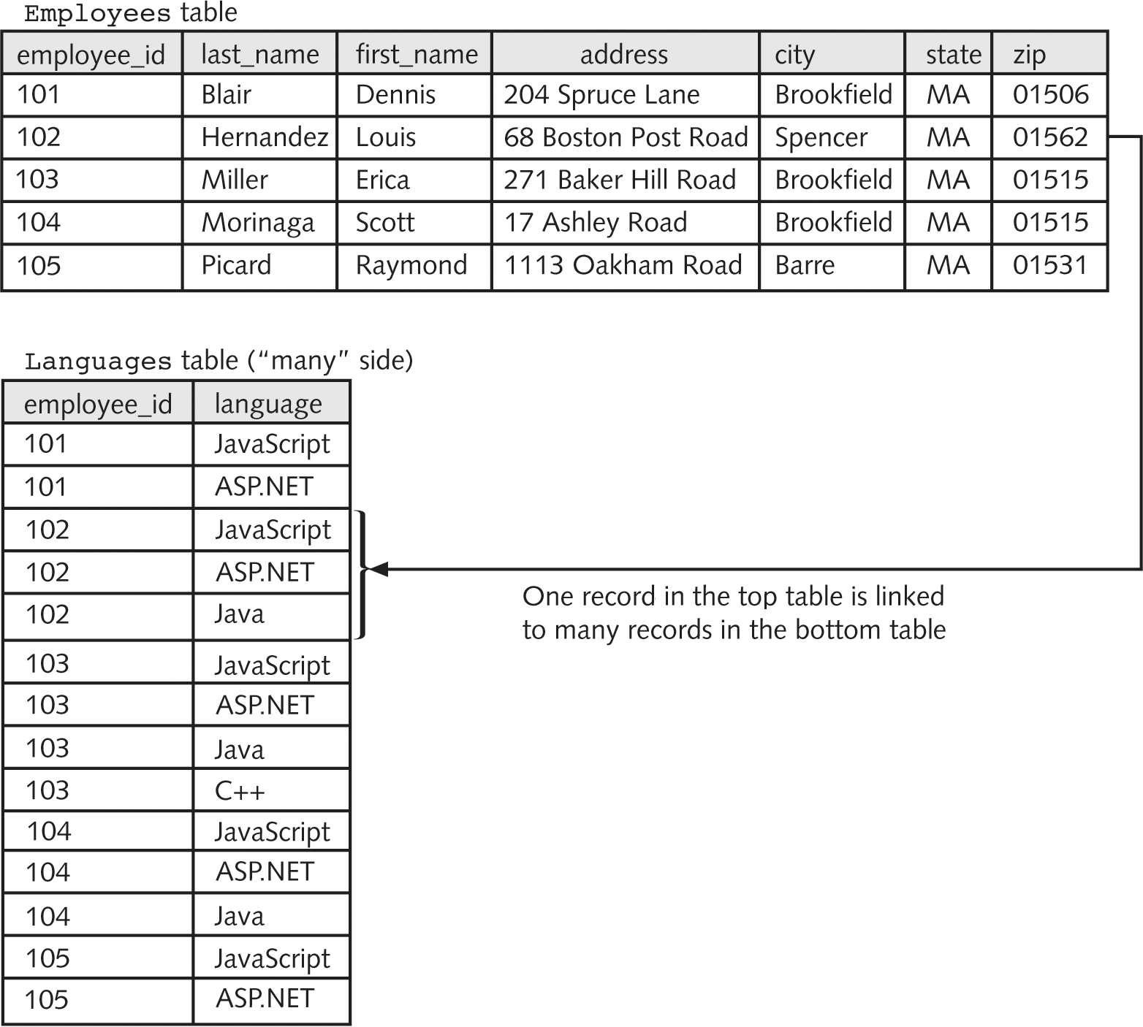
One-to-Many Relationship (continued)
Figure 7-4 One-to-many relationship
PHP Programming with MySQL, 2nd Edition

Slide 13
Many-to-Many Relationship
A many-to-many relationship exists in a relational database when many records in one table are related to many records in another table
A junction table creates a one-to-many relationship for each of the two tables in a
many-to-many relationship
A junction table contains foreign keys from the two tables
PHP Programming with MySQL, 2nd Edition

Slide 14
Working with Database Management Systems
A database management system (or DBMS) is an application or collection of applications used to access and manage a database
A schema is the structure of a database including its tables, fields, and relationships
A flat-file database management system is a system that stores data in a flat-file format
A relational database management system (or RDBMS) is a system that stores data in a relational format
PHP Programming with MySQL, 2nd Edition

Slide 15
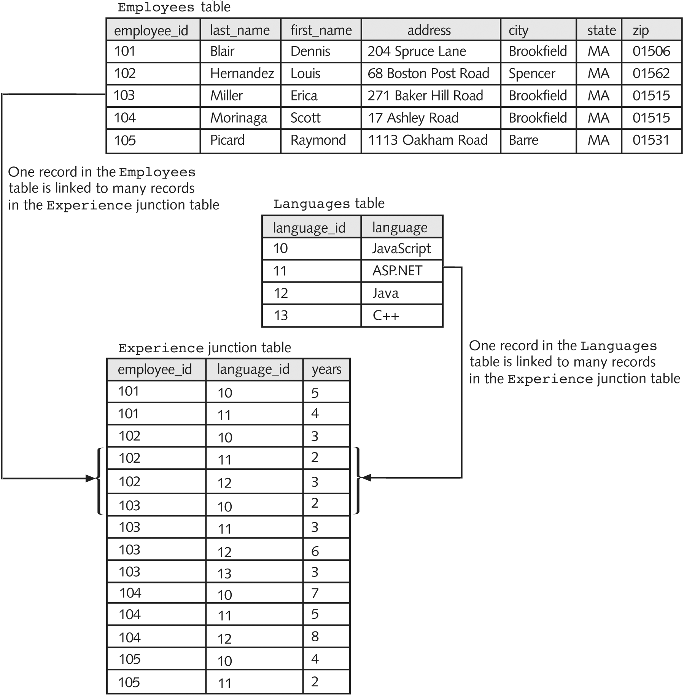
Working with Database Management Systems (continued)
Figure 7-5 Many-to-many relationship
PHP Programming with MySQL, 2nd Edition

Slide 16
Working with Database Management Systems (continued)
Important aspects of database management systems:
  The structuring and preservation of the
  database file
  Ensuring that data is stored correctly in a database’s tables, regardless of the database format
  Querying capability
PHP Programming with MySQL, 2nd Edition

Slide 17
Working with Database Management Systems (continued)
A query is a structured set of instructions and criteria for retrieving, adding, modifying, and deleting database information
Structured query language (or SQL) is a standard data manipulation language used among many database management systems
Open database connectivity (or ODBC) allows ODBC-compliant applications to access any data source for which there is an ODBC driver
PHP Programming with MySQL, 2nd Edition

Slide 18
Getting Started with
MySQL
The MySQL Monitor is a command-line program for manipulating MySQL databases
Connect to the MySQL server using a command-line connect
Commands are entered at the mysql-> command prompt in the console window
PHP Programming with MySQL, 2nd Edition

Slide 19
Logging in to MySQL
Enter the following command:
  mysql –h host –u user –p
Two accounts are created:
  Anonymous user account allows login without specifying a username or password
  root account (the primary administrative account for MySQL) is created without a password
  mysql –u root
Log out with the exit or quit commands
PHP Programming with MySQL, 2nd Edition

Slide 20
Logging in to MySQL (continued)
$ mysql –h php_db -u dongosselin -p[ENTER]
Enter password: **********[ENTER]
Welcome to the MySQL monitor. Commands end with ; or \g.
Your MySQL connection id is 6611 to server version: 4.1.9-nt
Type 'help;' or '\h' for help. Type '\c' to clear the buffer.
mysql>
Use the up and down arrow keys on the keyboard to scroll through previously entered commands
PHP Programming with MySQL, 2nd Edition

Slide 21
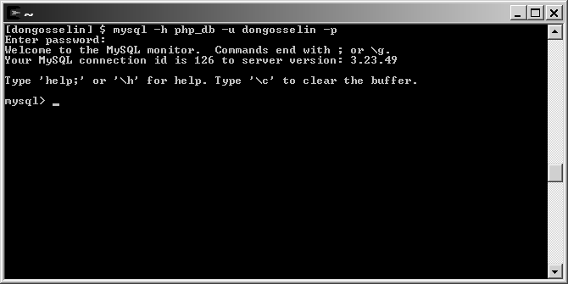
Logging in to MySQL (continued)
Figure 7-6 MySQL Monitor on a Windows platform
PHP Programming with MySQL, 2nd Edition

Slide 22
Working with the MySQL Monitor
At the mysql> command prompt terminate the command with a semicolon
  mysql> SELECT * FROM inventory;
Without a semicolon, the MySQL Monitor enters a multiple-line command and changes the prompt to ->
  mysql> SELECT * FROM inventory
  ->
The SQL keywords entered in the MySQL Monitor are not case sensitive
PHP Programming with MySQL, 2nd Edition

Slide 23
Understanding MySQL Identifiers
An alias is an alternate name used to refer to a table or field in SQL statements
The case sensitivity of database and table identifiers depends on the operating system
  Not case sensitive on Windows platforms
  Case sensitive on UNIX/Linux systems
MySQL stores each database in a directory of the same name as the database identifier
Field and index identifiers are case insensitive on all platforms
PHP Programming with MySQL, 2nd Edition

Slide 24
Understanding MySQL Identifiers (continued)
Identifiers that must be quoted using the backtick, or single quote, character (`)are
  An identifier that includes any character except standard alphanumeric characters, underscores (_) or dollar signs ($)
  Any identifier that contains one or more space characters
  An identifier that is a reserved word in MySQL
  An identifier made entirely of numeric digits
  An identifier that contains a backtick character
PHP Programming with MySQL, 2nd Edition

Slide 25
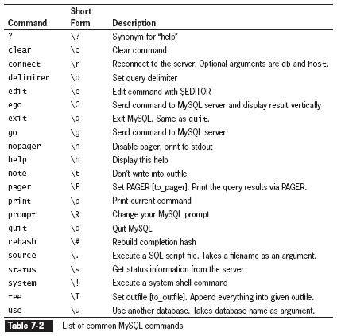
Getting Help with MySQL Commands
PHP Programming with MySQL, 2nd Edition

Slide 26
Creating Databases
Use the CREATE DATABASE statement to create a new database:
  mysql> CREATE DATABASE vehicle_fleet;[ENTER]
To use a new database, select it by executing the USE DATABASE statement
PHP Programming with MySQL, 2nd Edition

Slide 27
Selecting a Database
Use the DATABASE() function to return the name of the currently active database
mysql> SELECT DATABASE();[ENTER]
View the available databases using the SHOW DATABASES statement
mysql> SHOW databases;[ENTER]
Use the DROP DATABASE statement to remove all tables and delete a database
mysql> DROP DATABASE database;
PHP Programming with MySQL, 2nd Edition

Slide 28
Defining Database Tables
Data types that are assigned to fields determine how much storage space the computer allocates for the data in the database
Choose the smallest data type possible for each field
PHP Programming with MySQL, 2nd Edition

Slide 29
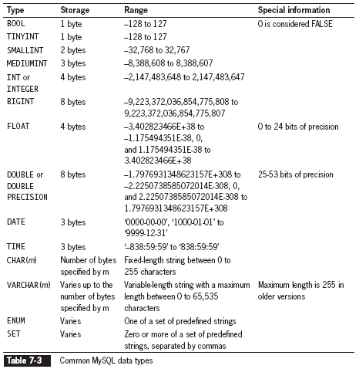
Defining Database Tables
(continued)
PHP Programming with MySQL, 2nd Edition

Slide 30
Creating Tables
Use the CREATE TABLE statement to create a new table and define the column names and data types for each column
  mysql> CREATE TABLE vehicles
  (license VARCHAR(10), make VARCHAR(25),
  model VARCHAR(50), miles FLOAT,
  assigned_to VARCHAR(40));[ENTER]
PHP Programming with MySQL, 2nd Edition

Slide 31
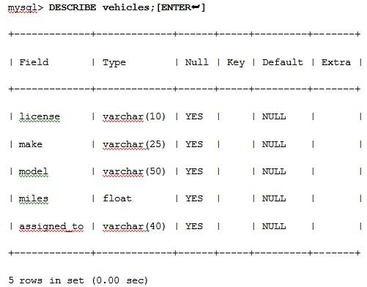
Viewing Table Structure
Use the DESCRIBE table_name statement to view the structure of the table
PHP Programming with MySQL, 2nd Edition

Slide 32
Changing Table Field Names
Use the ALTER TABLE to change the name of an existing field in a table using the following syntax
ALTER TABLE table_name ADD [COLUMN] (column_name column_type [, column_name column_type ...]);
In MySQL Monitor, enter the following:
  mysql> ALTER TABLE vehicles ADD COLUMN (model_year INT);[ENTER]
PHP Programming with MySQL, 2nd Edition

Slide 33
Modifying Column Types
Use the ALTER TABLE to rename columns of an existing field in a table using the following syntax
ALTER TABLE table_name CHANGE [COLUMN] column_name new_name column_type;
In MySQL Monitor, enter the following:
  mysql> ALTER TABLE vehicles CHANGE COLUMN miles mileage FLOAT;[ENTER]
PHP Programming with MySQL, 2nd Edition

Slide 34
Renaming Columns
Use the ALTER TABLE to rename columns using the following syntax
ALTER TABLE table_name MODIFY [COLUMN] column_name column_type;
In MySQL Monitor, enter the following:
  mysql> ALTER TABLE vehicles MODIFY COLUMN
  model_year SMALLINT;[ENTER]
PHP Programming with MySQL, 2nd Edition

Slide 35
Renaming Tables
Use the ALTER TABLE to change the name of an existing table using the following syntax
ALTER TABLE table_name RENAME [TO] new_name;
mysql> ALTER TABLE vehicles RENAME TO
company_cars;[ENTER]
PHP Programming with MySQL, 2nd Edition

Slide 36
Removing Columns
Use the ALTER TABLE to remove an existing field from a table using the following syntax
ALTER TABLE table_name DROP [COLUMN]
column_name;
mysql> ALTER TABLE company_cars DROP COLUMN
assigned_to;[ENTER]
PHP Programming with MySQL, 2nd Edition

Slide 37
Deleting Tables
Execute the DROP TABLE statement to remove all data and the table definition from a database
DROP TABLE table;
In MySQL Monitor, enter the following at the mysql> prompt:
mysql> DROP TABLE company_cars;[ENTER]
You must be logged in as the root user or have DROP privileges to delete a table.
PHP Programming with MySQL, 2nd Edition

Slide 38
Modifying User Privileges
Privileges are actions and operations a user can perform with a table or a database
For security purposes, user accounts should only be assigned the minimum necessary privileges to perform given tasks
PHP Programming with MySQL, 2nd Edition

Slide 39
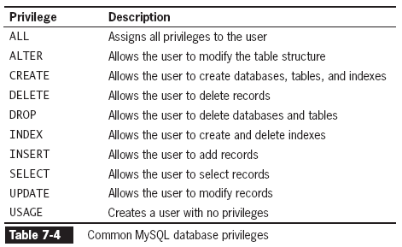
Modifying User Privileges
(continued)
PHP Programming with MySQL, 2nd Edition

Slide 40
Granting Privileges
The syntax for the GRANT statement is:
  GRANT privilege [(column)] [, privilege [(columns)]] ...
  ON {table | * | *.* | database.*}
  TO user [IDENTIFIED BY 'password'];
The GRANT statement creates the user account
if it does not exist and assigns the specified privileges
If the user account already exists, the GRANT statement just updates the privileges
PHP Programming with MySQL, 2nd Edition

Slide 41
Revoking Privileges
The syntax for the REVOKE statement is:
  REVOKE privilege [(column)] [, privilege [(columns)]] ...
  ON {table | * | *.* | database.*}
  FROM user;
The REVOKE ALL PRIVILEGES statement removes all privileges from a user account for a specified table or database
You must be logged in with the root account or have sufficient privileges to revoke privileges
from another user account
PHP Programming with MySQL, 2nd Edition

Slide 42
Adding Records
Use the INSERT statement to add individual records to a table
The syntax for the INSERT statement is:
INSERT INTO table_name (column1, column2, …)
VALUES(value1, value2, ...);
The values entered in the VALUES list must
be in the same order in which you defined the table fields
Specify NULL in any fields for which you do not have a value
PHP Programming with MySQL, 2nd Edition

Slide 43
Adding Records (continued)
In MySQL Monitor, enter the following code at the mysql> prompt:
mysql> INSERT INTO company_cars(license,
model_year, make, model, mileage)
VALUES('CK-2987', 2009, 'Toyota',
'Corolla', 3508.4);[ENTER]
PHP Programming with MySQL, 2nd Edition

Slide 44
Adding Records (continued)
The LOAD DATA statement, with the full path and name of a local text file, is used to add multiple records to a table
LOAD DATA INFILE 'file_path' INTO TABLE
table_name (column1, column2, …);
Each record in the text file must be placed on a separate line with a tab delimiter between each field
PHP Programming with MySQL, 2nd Edition

Slide 45
Adding Records (continued)
If the column list is omitted, the values on each line must be in the same order you defined the table fields
Use consecutive tabs with nothing between them to designate a column with no value
In MySQL Monitor, enter the following code at the mysql> prompt:
mysql> LOAD DATA INFILE 'company_cars.txt'
INTO TABLE company_cars;[ENTER]
PHP Programming with MySQL, 2nd Edition

Slide 46
Adding Records (continued)
The optional FIELDS TERMINATED BY clause of the LOAD DATA statement allows you to change the field separator to a character such as (~ or ,) instead of the default tab character
In MySQL Monitor, enter the following code at the mysql> prompt:
mysql> LOAD DATA INFILE 'company_cars.txt‘
INTO TABLE company_cars;[ENTER]
PHP Programming with MySQL, 2nd Edition

Slide 47
Retrieving Records
Use the SELECT statement to retrieve records from a table:
SELECT criteria FROM table_name;
Use the asterisk (*) wildcard with the SELECT statement to retrieve all fields from a table
To return multiple fields, separate field names with a comma
PHP Programming with MySQL, 2nd Edition

Slide 48
Retrieving Records (continued)
In MySQL Monitor, enter the following code at the mysql> prompt:
mysql> SELECT model, mileage FROM
company_cars;[ENTER]
PHP Programming with MySQL, 2nd Edition

Slide 49
Using Aggregate Functions
Aggregate functions summarize data in record sets rather than display the individual records
The COUNT() function is unique in that
  The wildcard (*) can be used as a function argument instead of a field name
  The keyword DISTINCT can be used after the opening parentheses
The DISTINCT keyword can also be used with the SELECT statement to retrieve records with a unique value in the WHERE clause
PHP Programming with MySQL, 2nd Edition

Slide 50
Using Aggregate Functions (continued)
To retrieve aggregate values for groups of records, use the GROUP BY clause and include the fields that you use to group the records as part of the query
In MySQL Monitor, enter the following code at the mysql> prompt:
  mysql> SELECT model_year, AVG(mileage)
  FROM company_cars GROUP BY
  model_year;[ENTER]
PHP Programming with MySQL, 2nd Edition

Slide 51
Sorting Query Results
Use the ORDER BY keyword with the SELECT statement to perform an alphanumeric sort of the results returned from a query
In MySQL Monitor, enter the following code at the mysql> prompt:
  mysql> SELECT make, model FROM inventory
  ORDER BY make, model;[ENTER]
PHP Programming with MySQL, 2nd Edition

Slide 52
Sorting Query Results (continued)
To perform a reverse sort, add the DESC keyword after the name of the field by which
you want to perform the sort
In MySQL Monitor, enter the following code at the mysql> prompt:
mysql> SELECT make, model FROM
company_cars ORDER BY make DESC,
model;[ENTER]
PHP Programming with MySQL, 2nd Edition

Slide 53
Filtering Query Results
The criteria portion of the SELECT statement determines which fields to retrieve from a table
You can also specify which records to return by using the WHERE keyword
In MySQL Monitor, enter the following code at the mysql> prompt:
mysql> SELECT * FROM inventory WHERE
make='Martin‘;[ENTER]
PHP Programming with MySQL, 2nd Edition

Slide 54
Filtering Query Results (continued)
Use the keywords AND and OR to specify more detailed conditions about the records you want to return
In MySQL Monitor, enter the following code using the AND keyword at the mysql> prompt:
mysql> SELECT * FROM company_cars
WHERE model_year=2007 AND
mileage<60000;[ENTER]
PHP Programming with MySQL, 2nd Edition

Slide 55
Filtering Query Results (continued)
In MySQL Monitor, enter the following code using the OR keyword at the mysql> prompt:
mysql> SELECT * FROM company_cars
WHERE make='Toyota’ OR
make='Honda‘ ORDER BY mileage ;[ENTER]
PHP Programming with MySQL, 2nd Edition

Slide 56
Updating Records
To update records in a table, use the UPDATE statement
The syntax for the UPDATE statement is:
      UPDATE table_name
      SET column_name=value
      WHERE condition;
  The UPDATE keyword specifies the name of the table to update
  The SET keyword specifies the value to assign to the fields in the records that match the condition in the WHERE keyword
PHP Programming with MySQL, 2nd Edition

Slide 57
Updating Records (continued)
In MySQL Monitor, enter the following code using the OR keyword at the mysql> prompt:
  mysql> UPDATE company_cars SET mileage=368.2
  WHERE make='Ford’ AND model='Fusion';[ENTER]
PHP Programming with MySQL, 2nd Edition

Slide 58
Deleting Records
Use the DELETE statement to delete records in a table
The syntax for the DELETE statement is:
DELETE FROM table_name
WHERE condition;
The DELETE statement deletes all records that match the condition
To delete all the records in a table, leave off the WHERE keyword
PHP Programming with MySQL, 2nd Edition

Slide 59
Deleting Records (continued)
In MySQL Monitor, enter the following code at the mysql> prompt:
mysql> DELETE FROM company_cars WHERE
model_year=2006 AND make='Honda'
AND model='Accord';[ENTER]
To delete all records from a table, omit the WHERE clause
PHP Programming with MySQL, 2nd Edition

Slide 60
Summary
A database is an ordered collection of information from which a computer program can quickly access information
A record in a database is a single, complete set of related information
Fields are the individual categories of information stored in a record
A flat-file database stores information in a single table
PHP Programming with MySQL, 2nd Edition

Slide 61
Summary (continued)
A relational database stores information across multiple related tables
A query is a structured set of instructions and criteria for retrieving, adding, modifying, and deleting database information
Structured query language, or SQL (pronounced sequel), is a standard data manipulation language among many database management systems
PHP Programming with MySQL, 2nd Edition

Slide 62
Summary (continued)
MySQL Monitor is a command-line program that you use to manipulate MySQL databases
To work with a database, you must first select it by executing the USE DATEBASE statement
You use the CREATE DATABASE statement to create a new database
To delete a database, you execute the DROP DATABASE statement, which removes all tables from the database and deletes the database itself
PHP Programming with MySQL, 2nd Edition

Slide 63
Summary (continued)
The fields in a table also store data according to type
To keep your database from growing too large, you should choose the smallest data type possible for each field
To create a table, you use the CREATE TABLE statement, which specifies the table and column names and the data type for each column
PHP Programming with MySQL, 2nd Edition

Slide 64
Summary (continued)
To modify a table, you use the ALTER TABLE statement, which specifies the table being changed and the change to make
To delete a table, you execute the DROP TABLE statement, which removes all data and the table definition
You use a GRANT statement to create user accounts and assign privileges, which refer to the operations that a user can perform with a database
PHP Programming with MySQL, 2nd Edition

Slide 65
Summary (continued)
You use the REVOKE statement to take away privileges from an existing user account for a specified table or database
You add individual records to a table with the INSERT statement
To add multiple records to a database, you use the LOAD DATA statement with a local text file that contains the records you want to add
PHP Programming with MySQL, 2nd Edition

Slide 66
Summary (continued)
You use the SELECT statement to retrieve records from a table
You use the ORDER BY keyword with the SELECT statement to perform an alphanumeric sort of the results returned from a query
To perform a reverse sort, add the DESC keyword after the name of the field by which you want to perform the sort
PHP Programming with MySQL, 2nd Edition

Slide 67
Summary (continued)
You can specify which records to return from a database by using the WHERE keyword
You use the UPDATE statement to update records in a table
You use the DELETE statement to delete records from a table
The phpMyAdmin graphical tool simplifies the tasks associated with creating and maintaining databases and tables
PHP Programming with MySQL, 2nd Edition

